Slide 1
Transfer Learning

Slide 2
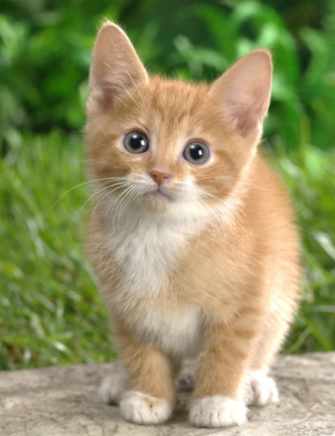
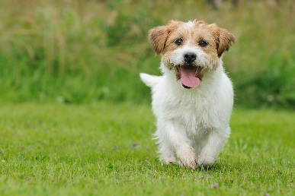
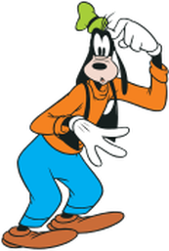

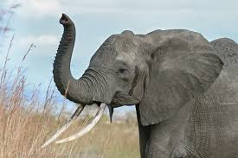
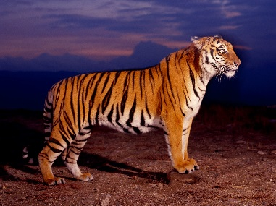
Transfer Learning
http://weebly110810.weebly.com/396403913129399.html
http://www.sucaitianxia.com/png/cartoon/200811/4261.html
Dog/Cat
Classifier
cat
dog
Data not directly related to the task considered
elephant
tiger
dog
cat
Similar domain, different tasks
Different domains, same task

Slide 3

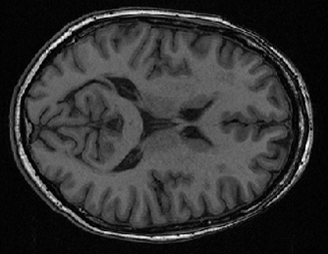

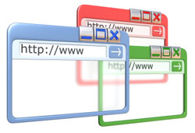
Why?
http://www.bigr.nl/website/structure/main.php?page=researchlines&subpage=project&id=64
http://www.spear.com.hk/Translation-company-Directory.html
Task Considered
Data not directly related
Speech
Recognition
English
Chinese
Taiwanese
……
Image Recognition
Medical
Images
Text
Analysis
Specific domain
Webpages
Notes:
Transfer
Self-taught

Slide 4

Transfer Learning
Example in real life
研究生
漫畫家
研究生
漫畫家
跑實驗
畫分鏡
指導教授
責編
投稿期刊
投稿 jump
爆漫王
(word embedding knows that)
Notes:
even sick
手速
進度報告

Slide 5
Transfer Learning - Overview
Source Data (not directly related to the task)
labelled
unlabeled
Model Fine-tuning
labelled
Warning: different terminology in different literature
Target Data
unlabeled

Slide 6
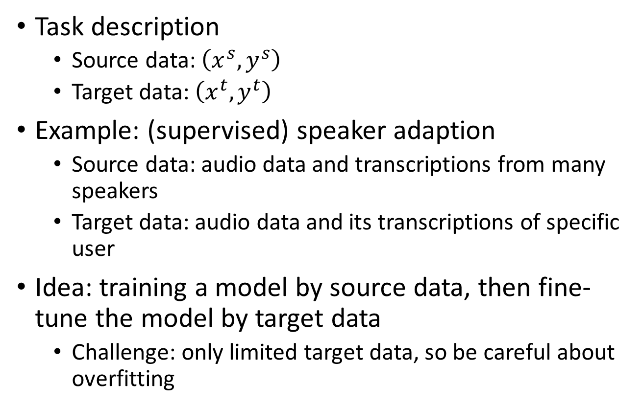
Model Fine-tuning
One-shot learning: only a few examples in target domain
Task description
Source data: $\left(x^{s},y^{s}\right)$
Target data: $\left(x^{t},y^{t}\right)$
Example: (supervised) speaker adaption
Source data: audio data and transcriptions from many speakers
Target data: audio data and its transcriptions of specific user
Idea: training a model by source data, then fine-tune the model by target data
Challenge: only limited target data, so be careful about overfitting
A large amount
Very little

Slide 7
Conservative Training
Output layer
output close
Output layer
parameter close
initialization
Input layer
Input layer
Source data
(e.g. Audio data of
Many speakers)
Target data (e.g. A little data from target speaker)
Notes:
Just train cannot work
Extra constraint
To evaluate how the size of the adaptation set affects the result, the number of
adaptation utterances varies from 5 (32 s) to 200 (22min).

Slide 8
Layer Transfer
Output layer
Copy some parameters
Target data
Source data
Input layer
1. Only train the rest layers (prevent overfitting)
2. fine-tune the whole network (if there is sufficient data)
Notes:
Where shold I add -> I don’t know

Slide 9

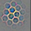
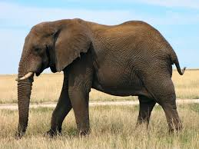



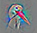
Layer Transfer
Which layer can be transferred (copied)?
Speech: usually copy the last few layers
Image: usually copy the first few layers
Pixels
Layer 1
Layer 2
Layer L
……
……
……
elephant
……
……
……
……
……
……

Slide 10
Layer Transfer - Image
fine-tune the whole network
Source: 500 classes from ImageNet
Only train the rest layers
Target: another 500 classes from ImageNet
Jason Yosinski, Jeff Clune, Yoshua Bengio, Hod Lipson, “How transferable are features in deep neural networks?”, NIPS, 2014

Slide 11
Layer Transfer - Image
Only train the rest layers
Jason Yosinski, Jeff Clune, Yoshua Bengio, Hod Lipson, “How transferable are features in deep neural networks?”, NIPS, 2014
Notes:
60,0000

Slide 12
Transfer Learning - Overview
Source Data (not directly related to the task)
labelled
unlabeled
Fine-tuning
labelled
Multitask Learning
Target Data
unlabeled

Slide 13
Multitask Learning
The multi-layer structure makes NN suitable for multitask learning
Task A
Task B
Task A
Task B
Input feature
Input feature for task A
Input feature for task B

Slide 14
Multitask Learning - Multilingual Speech Recognition
states of French
states of German
states of Spanish
states of Italian
states of Mandarin
Human languages share some common characteristics.
acoustic features
Similar idea in translation: Daxiang Dong, Hua Wu, Wei He, Dianhai Yu and Haifeng Wang, "Multi-task learning for multiple language translation.“, ACL 2015
Notes:
Should I put Tanja’s AF here?

Slide 15
Multitask Learning - Multilingual
Mandarin only
Character Error Rate
With European Language
Hours of training data for Mandarin
Huang, Jui-Ting, et al. "Cross-language knowledge transfer using multilingual deep neural network with shared hidden layers." ICASSP, 2013
Notes:
Translation/summarization

Slide 16
Progressive Neural Networks
Task 1
Task 2
Task 3
input
input
input
Andrei A. Rusu, Neil C. Rabinowitz, Guillaume Desjardins, Hubert Soyer, James Kirkpatrick, Koray Kavukcuoglu, Razvan Pascanu, Raia Hadsell, “Progressive Neural Networks”, arXiv preprint 2016
Notes:
https://arxiv.org/pdf/1606.04671v3.pdf

Slide 17
Chrisantha Fernando, Dylan Banarse, Charles Blundell, Yori Zwols, David Ha, Andrei A. Rusu, Alexander Pritzel, Daan Wierstra, “PathNet: Evolution Channels Gradient Descent in Super Neural Networks”, arXiv preprint, 2017

Slide 18
Transfer Learning - Overview
Source Data (not directly related to the task)
labelled
unlabeled
Fine-tuning
labelled
Multitask Learning
Target Data
Domain-adversarial training
unlabeled

Slide 19

Task description
Training data
Source data: $\left(x^{s},y^{s}\right)$
Target data: $\left(x^{t}\right)$
Same task, mismatch
Testing data
with label
without label

Slide 20
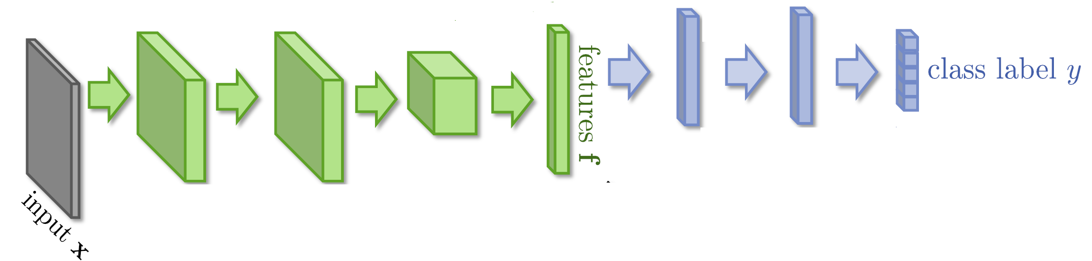


Domain-adversarial training

Slide 21
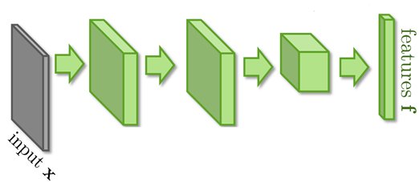
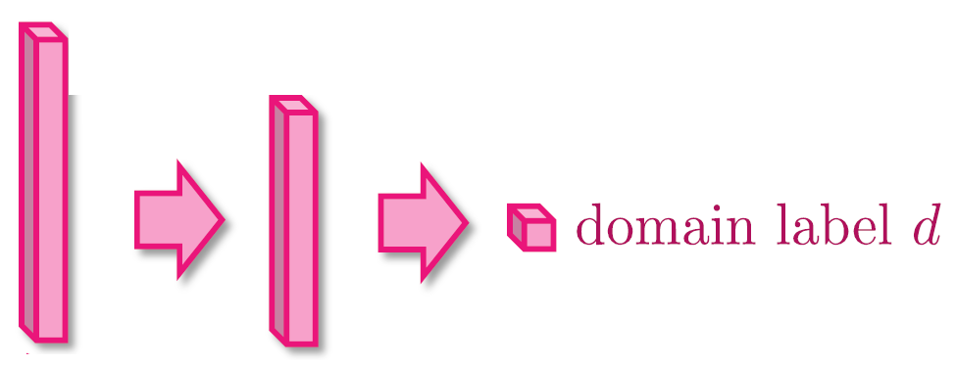


Domain-adversarial training
Similar to GAN
feature extractor
Too easy to feature extractor ……
Domain classifier

Slide 22
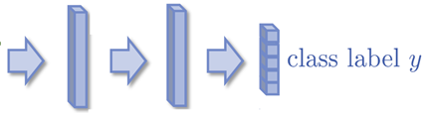
Domain-adversarial training
Maximize label classification accuracy + minimize domain classification accuracy
Maximize label classification accuracy
feature extractor
Label predictor
Domain classifier
Not only cheat the domain classifier, but satisfying label classifier at the same time
Maximize domain classification accuracy
This is a big network, but different parts have different goals.

Slide 23
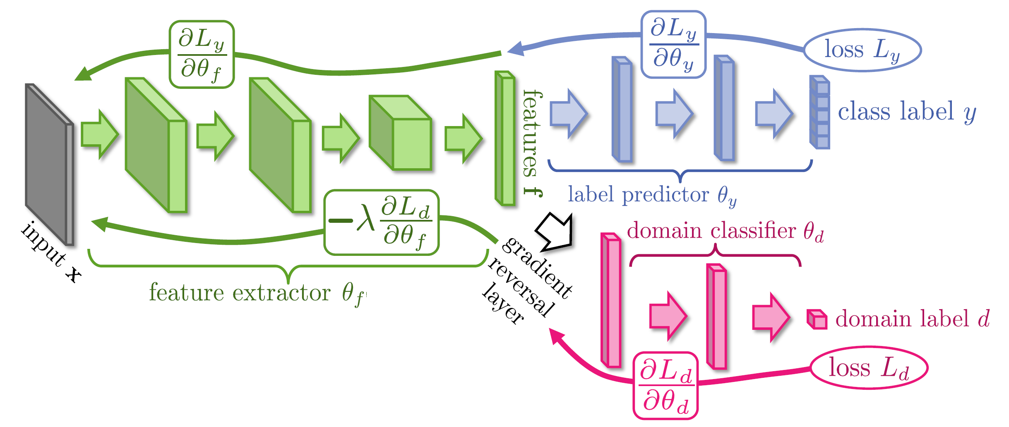
Domain-adversarial training
Domain classifier fails in the end
It should struggle ……
Yaroslav Ganin, Victor Lempitsky, Unsupervised Domain Adaptation by Backpropagation, ICML, 2015
Hana Ajakan, Pascal Germain, Hugo Larochelle, François Laviolette, Mario Marchand, Domain-Adversarial Training of Neural Networks, JMLR, 2016

Slide 24
Domain-adversarial training
Yaroslav Ganin, Victor Lempitsky, Unsupervised Domain Adaptation by Backpropagation, ICML, 2015
Hana Ajakan, Pascal Germain, Hugo Larochelle, François Laviolette, Mario Marchand, Domain-Adversarial Training of Neural Networks, JMLR, 2016

Slide 25
Transfer Learning - Overview
Source Data (not directly related to the task)
labelled
unlabeled
Fine-tuning
labelled
Multitask Learning
Target Data
Domain-adversarial training
unlabeled
Zero-shot learning

Slide 26
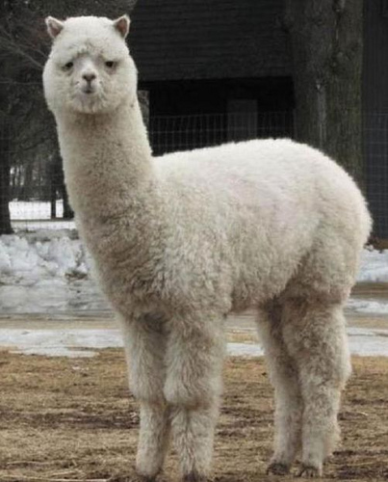
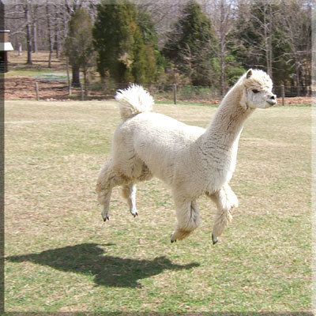
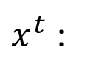
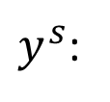
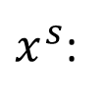
Zero-shot Learning
http://evchk.wikia.com/wiki/%E8%8D%89%E6%B3%A5%E9%A6%AC
Training data
Source data: $\left(x^{s},y^{s}\right)$
Target data: $\left(x^{t}\right)$
Different tasks
Testing data
$x^{s}$:
……
$x^{t}$:
$y^{s}$:
cat
dog
……
In speech recognition, we can not have all possible words in the source (training) data.
How we solve this problem in speech recognition?

Slide 27
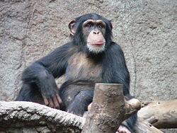
Zero-shot Learning
Representing each class by its attributes
Training
1
0
0
1
1
1
Database
furry
4 legs
tail
furry
4 legs
tail
attributes
 | furry | 4 legs | tail | …
Dog | O | O | O
Fish | X | X | O
Chimp | O | X | X
…
NN
NN
class
sufficient attributes for one to one mapping

Slide 28
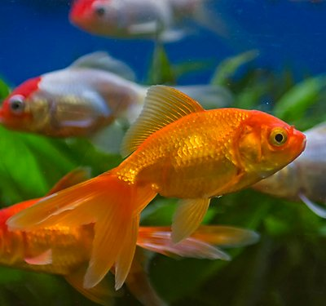
Zero-shot Learning
Representing each class by its attributes
Testing
Find the class with the most similar attributes
0
0
1
furry
4 legs
tail
attributes
 | furry | 4 legs | tail | …
Dog | O | O | O
Fish | X | X | O
Chimp | O | X | X
…
NN
class
sufficient attributes for one to one mapping

Slide 29
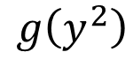
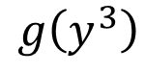
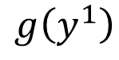
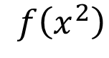
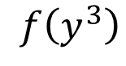
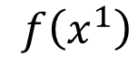
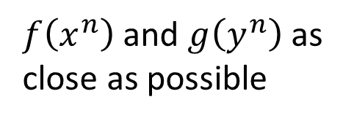
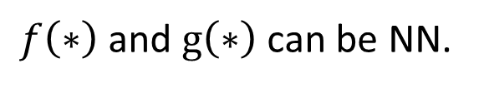
Zero-shot Learning
$f\left(∗\right)$ and $g\left(∗\right)$ can be NN.
Training target:
$f\left(x^{n}\right)$ and $g\left(y^{n}\right)$ as close as possible
Attribute embedding
x²
y¹ (attribute of chimp)
y² (attribute of dog)
x¹
$$f\left(x^{2}\right)$$
$$g\left(y^{2}\right)$$
$$f\left(x^{1}\right)$$
$$g\left(y^{1}\right)$$
y³ (attribute of Grass-mud horse)
$$g\left(y^{3}\right)$$
$$f\left(y^{3}\right)$$
x³
Embedding Space

Slide 30
Zero-shot Learning
What if we don’t have database
Attribute embedding + word embedding
y¹ (attribute of chimp)
x²
V(chimp)
y² (attribute of dog)
V(dog)
x¹
$$f\left(x^{2}\right)$$
$$g\left(y^{2}\right)$$
$$f\left(x^{1}\right)$$
$$g\left(y^{1}\right)$$
y³ (attribute of Grass-mud horse)
$$g\left(y^{3}\right)$$
$$f\left(y^{3}\right)$$
V(Grass-mud_horse)
x³
Embedding Space

Slide 31
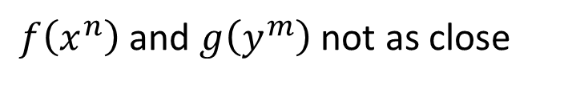
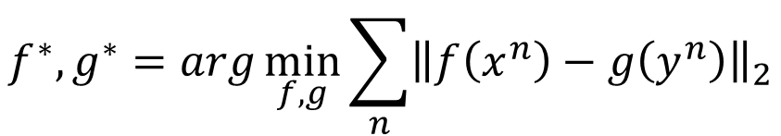
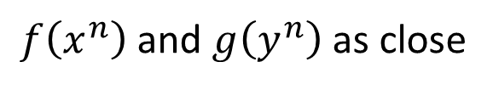

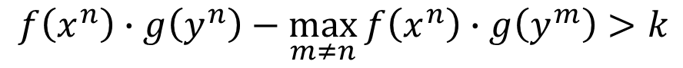


Zero-shot Learning
$$f^{∗},g^{∗}=arg\min_{f,g}{\sum_{n}{{\left\|f\left(x^{n}\right)−g\left(y^{n}\right)\right\|}_{2}}}$$
Problem?
$$f^{∗},g^{∗}=arg\min_{f,g}{\sum_{n}{max\left(0,k−f\left(x^{n}\right)∙g\left(y^{n}\right)+\max_{m≠n}{f\left(x^{m}\right)∙g\left(x^{m}\right)}\right)}}$$
$$f^{∗},g^{∗}=arg\min_{f,g}{\sum_{n}{max\left(0,m−f\left(x^{n}\right)∙g\left(x^{n}\right)+\max_{m≠n}{f\left(x^{n}\right)∙g\left(y^{m}\right)}\right)}}$$
Margin you defined
Zero loss:
$$k−f\left(x^{n}\right)∙g\left(y^{n}\right)+\max_{m≠n}{f\left(x^{n}\right)∙g\left(y^{m}\right)}<0$$
$$f\left(x^{n}\right)∙g\left(y^{n}\right)−\max_{m≠n}{f\left(x^{n}\right)∙g\left(y^{m}\right)}>k$$
$f\left(x^{n}\right)$ and $g\left(y^{n}\right)$ as close
$f\left(x^{n}\right)$ and $g\left(y^{m}\right)$ not as close

Slide 32
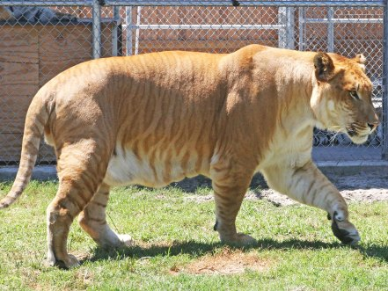
Zero-shot Learning
Convex Combination of Semantic Embedding
lion
tiger
V(tiger)
0.5
0.5
Find the closest word vector
V(liger)
NN
0.5V(tiger)+0.5V(lion)
V(lion)
Only need off-the-shelf NN for ImageNet and word vector

Slide 33
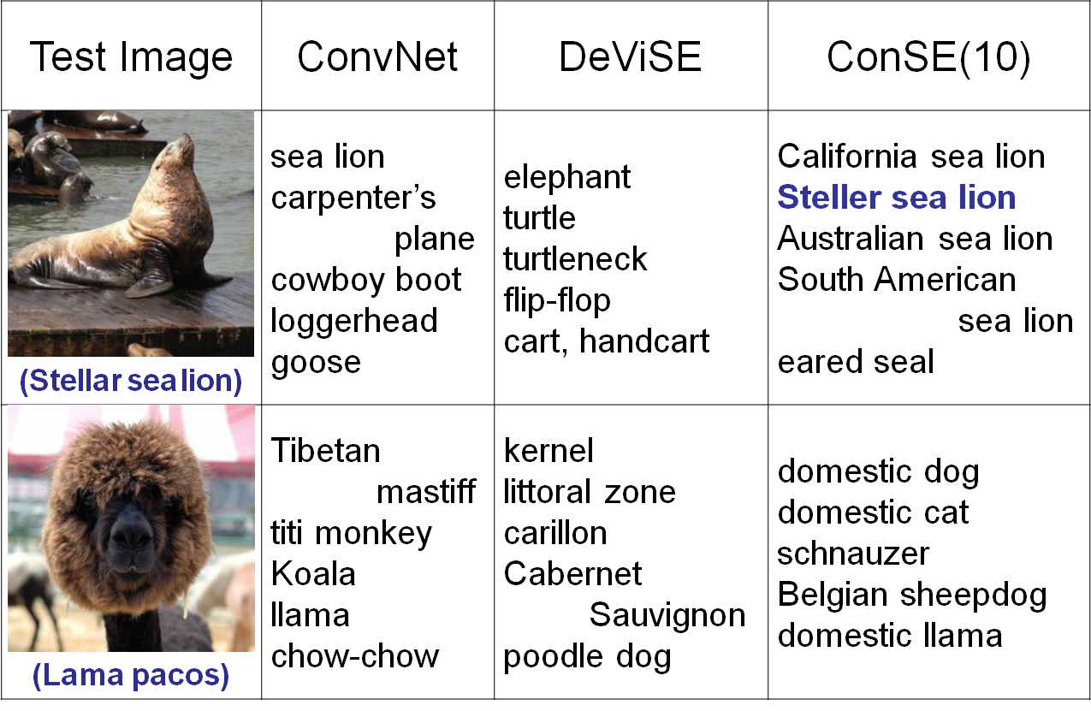
https://arxiv.org/pdf/1312.5650v3.pdf
Notes:
高領毛衣

Slide 34
Example of Zero-shot Learning
Melvin Johnson, Mike Schuster, Quoc V. Le, Maxim Krikun, Yonghui Wu, Zhifeng Chen, Nikhil Thorat. Google’s Multilingual Neural Machine Translation System: Enabling Zero-Shot Translation, arXiv preprint 2016

Slide 35
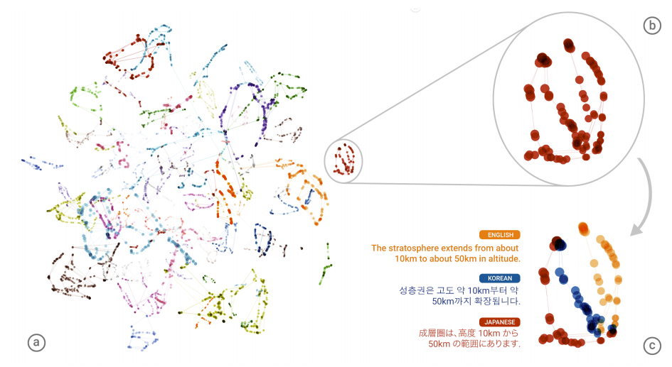
Example of Zero-shot Learning
Notes:
Stratosphere同溫層

Slide 36
Transfer Learning - Overview
Source Data (not directly related to the task)
labelled
unlabeled
Self-taught learning
Fine-tuning
Rajat Raina , Alexis Battle , Honglak Lee , Benjamin Packer , Andrew Y. Ng, Self-taught learning: transfer learning from unlabeled data, ICML, 2007
labelled
Multitask Learning
Target Data
Different from semi-supervised learning
Domain-adversarial training
unlabeled
Self-taught Clustering
Wenyuan Dai, Qiang Yang, Gui-Rong Xue, Yong Yu, "Self-taught clustering", ICML 2008
Zero-shot learning

Slide 37
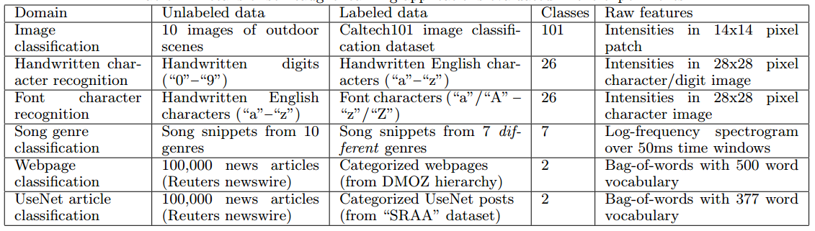
Self-taught learning
Learning to extract better representation from the source data (unsupervised approach)
Extracting better representation for target data

Slide 38
Acknowledgement
感謝 劉致廷 同學於上課時發現投影片上的錯誤

Slide 39
Appendix

Slide 40
More about Zero-shot learning
Mark Palatucci, Dean Pomerleau, Geoffrey E. Hinton, Tom M. Mitchell, “Zero-shot Learning with Semantic Output Codes”, NIPS 2009
Zeynep Akata, Florent Perronnin, Zaid Harchaoui and Cordelia Schmid, “Label-Embedding for Attribute-Based Classification”, CVPR 2013
Andrea Frome, Greg S. Corrado, Jon Shlens, Samy Bengio, Jeff Dean, Marc'Aurelio Ranzato, Tomas Mikolov, “DeViSE: A Deep Visual-Semantic Embedding Model”, NIPS 2013
Mohammad Norouzi, Tomas Mikolov, Samy Bengio, Yoram Singer, Jonathon Shlens, Andrea Frome, Greg S. Corrado, Jeffrey Dean, “Zero-Shot Learning by Convex Combination of Semantic Embeddings”, arXiv preprint 2013
Subhashini Venugopalan, Lisa Anne Hendricks, Marcus Rohrbach, Raymond Mooney, Trevor Darrell, Kate Saenko, “Captioning Images with Diverse Objects”, arXiv preprint 2016

